Slide 1

Matomo in EDB

Slide 2



CX Datahub Datasets
Following Datasets are available as part of CX Data Hub
Tables considered
Website:
Geo location
Devices
Sessions
Actions
Web application:
Geo location
Devices
Sessions
Actions
Tables considered
Survey question
Survey response
Tables considered
Activity
Annotation keyword targets
Annotation keywords
Annotation keywords sig
Campaign
Category
Country
CRM Product
Document usage
Documents
Document version
Document relationship
Key message
Link target
Match text variation
Product
User

Slide 3
KPI’s to be Achieved
Following are the list of KPI’s for each channel data
Number of survey responses filled
Number of survey responses filled for each channel
Overall survey response interaction ratio
Number Of Visits
Number Of Visits in last 6 months
Number Of Visits in last 3 months
Number of visitors
Visit duration
Average visit duration
Average session duration
Number of total interactions
Number of interactions per session
Avg. interactions per session
Average time per session

Slide 4
Matomo – Website Analytics

Slide 5
Dataset Details : Ingested (Lake Layer : Raw Data)
Sr No | Data Source | Table Name | Frequency | Load Strategy | Table Name
1 | Matomo |  | Daily | Truncate and Load | web_traffic_matomo_src
2 | Matomo | web_traffic_matomo_src | Daily | Upsert | web_traffic_matomo_stg
5

Slide 6
Dataset Details : Curated Tables
Sr No | Data Source | Lake Table Name | Frequency | Load Strategy | Hub/Mart Table Name
1 | Matomo | web_traffic_matomo_stg | Daily | Truncate and Load | ref_geo_matomo
2 | Matomo | web_traffic_matomo_stg | Daily | Truncate and Load | ref_devices_matomo
3 | Matomo | web_traffic_matomo_stg | Daily | Truncate and Load | txn_session_matomo
4 | Matomo | web_traffic_matomo_stg | Daily | Truncate and Load | txn_action_matomo
6

Slide 7
Matomo ERD – Data model
txn_session_matomo
ref_camp_crm
ref_geo_matomo
ref_devices_matomo
txn_action_matomo
ref_geogrpy_intl
ref_digital_mkt_asset_gem
Ref_cust_crm

Slide 8
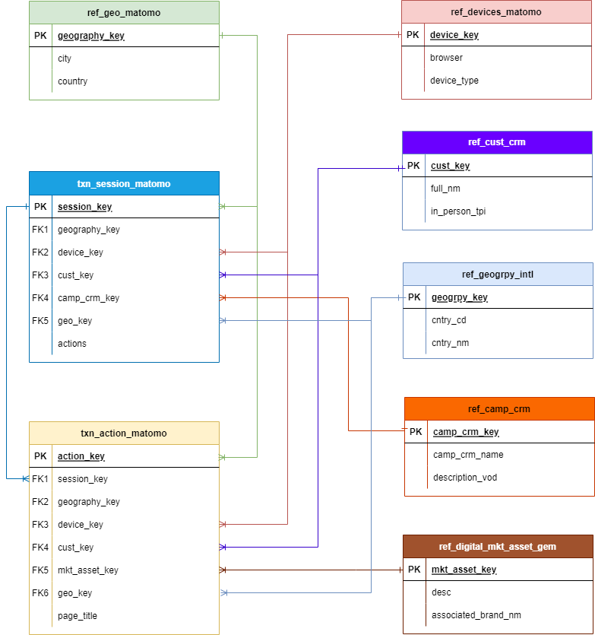
Matomo ERD – Data model
Data Model

Slide 9
Table Joins :
TableName1 | TableName2 | Join Condition
REF_GEO_MATOMO | REF_GEOGRPY_INTL | REF_GEO_MATOMO.GEO_KEY = REF_GEOGRPY_INTL.GEOGRPY_KEY
TXN_SESSION_MATOMO | REF_GEO_MATOMO | TXN_SESSION_MATOMO.GEOGRPY_KEY = REF_GEO_MATOMO.GEOGRPY_KEY
TXN_SESSION_MATOMO | REF_DEVICES_MATOMO | TXN_SESSION_MATOMO.DEVICE_KEY = REF_DEVICES_MATOMO.DEVICE_KEY
TXN_SESSION_MATOMO | REF_GEOGRPY_INTL | TXN_SESSION_MATOMO.GEO_KEY = REF_GEOGRPY_INTL.GEOGRPY_KEY
TXN_SESSION_MATOMO | REF_CAMP_CRM | TXN_SESSION_MATOMO.CAMP_CRM_KEY = REF_CAMP_CRM.CAMP_CRM_KEY
TXN_SESSION_MATOMO | REF_CUST_CRM | TXN_SESSION_MATOMO.CUST_KEY = REF_CUST_CRM.CUST_KEY
TXN_ACTION_MATOMO | TXN_SESSION_MATOMO | TXN_ACTION_MATOMO.SESSION_KEY = TXN_SESSION_MATOMO.SESSION_KEY
TXN_ACTION_MATOMO | REF_GEO_MATOMO | TXN_ACTION_MATOMO.GEOGRPY_KEY = REF_GEO_MATOMO.GEOGRPY_KEY
TXN_ACTION_MATOMO | REF_DEVICES_MATOMO | TXN_ACTION_MATOMO.DEVICE_KEY = REF_DEVICES_MATOMO.DEVICE_KEY
TXN_ACTION_MATOMO | REF_GEOGRPY_INTL | TXN_ACTION_MATOMO.GEO_KEY = REF_GEOGRPY_INTL.GEOGRPY_KEY
TXN_ACTION_MATOMO | REF_DIGITAL_MKT_ASSET_GEM | TXN_ACTION_MATOMO.MKT_ASSET_KEY = REF_DIGITAL_MKT_ASSET_GEM.MKT_ASSET_KEY
TXN_ACTION_MATOMO | REF_CUST_CRM | TXN_ACTION_MATOMO.CUST_KEY = REF_CUST_CRM.CUST_KEY
9

Slide 10
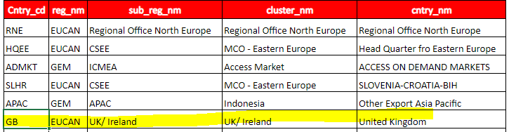
Basic Measures and data are now available in the model. (mostly count of session and Actions/events).
There are a few things that came up when modelling this basic version:
• The model was built on the assumption that there could be Sessions without Actions/events (and vice versa) – that is not the case currently. Meaning that upon confirmation with Matomo that there will be no Sessions without Actions/events we should model accordingly.
• Campaign currently in EDB is always “unknown”. This means that either:
o There is no link between SMILE Campaign and the site campaign – and product cannot be obtained from the campaign
o There is indirect link between both:
▪ Mapping file needs to be build to link the campaigns
▪ Sites campaign id needs to be built so that a link can be established
• There is no direct product association. This likely can be built based on the sites (for some) but surely multiple products can be looked at in a given site and it will depend on the page/video/…
• We need to understand what timezone the data is recorded in – this will likely depend on the site if not UTC for all. There is also a local time, but is likely not useful for most measures.
• Data being considered currently the “Server Date Time” of each session. Other candidates include first and last action time - There are sessions that span multiple dates based on this.
• Candidates for excluding test:
o Some sites are dev/test
o Campaign Source has some “Test”
o Campaign Placement has takedatest
o Campaign Group has some test
• There is no data identified as Ireland – Is this expected?
• We need to understand where is the Country coming from, if this is by site?
• There are very few Session linked to SMILE HCPs.

Slide 11
KPIs we would want to track in OCE Dashboard (All metrics with known HCPs)
How do we link to filters? Target filter, segmentation filter, channel etc
Reach
Create Web as a channel type
# of known HCPs reached and # Reaches with known HCPs
Acquisition with breakdown of mtm_parameters (source, medium, campaign, content) and Metrics detailed in
“Acquisition” slide 13
Engagement
By Channel. Metrics detailed in “Behaviour slide” slide 14
Conversion (Goals and Premium Engagement- both in “Goal Name” table) Is the measure “#Matomo Actions & Events” linked to goals?
# and % Takeda ID registrations + no consent. Can we identify this metric and # that actually successfully registered and ended up in SMILE with Takeda ID? Or does Takeda ID automatically get generated regardless of whether HCP becomes a lead?
sign up>matched in SMILE
sign up>lead>matched in SMILE
# and % Successful Takeda ID registrations + consent. Can we identify this metric and new signups and new consent that ended up in SMILE (someone could sign up and click to consent, but might already have consent in SMILE > will not result in new consent):
sign up>matched in SMILE + consent
sign up>lead>matched in SMILE + consent
# and % successful event signups (where applicable)
# and % successful completion of form ie request call back (where applicable) Forms table exists
Other conversions specific to the websites: I.e Uncover Dengue- country clicks, fact sheet downloads

Slide 12
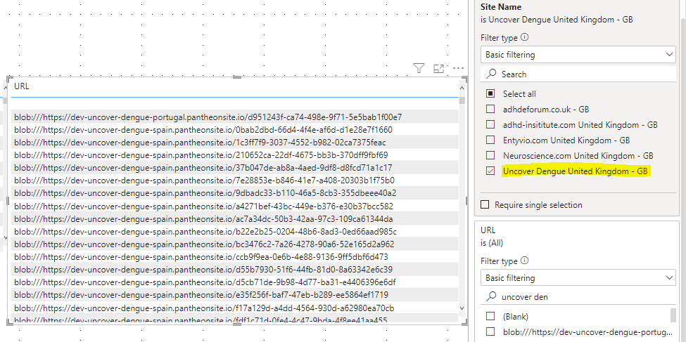
Site Names
Could we manually map the websites to the parent product?? – no RDH has multiple products
URL field – Looks like we are getting other countries data, C user drives, dev pages? Example Uncover Dengue United Kingdom – GB, selected, urls include Spanish links
Need to apply “Source Country Code” is GB – Can other countries data be filtered out?

Slide 13
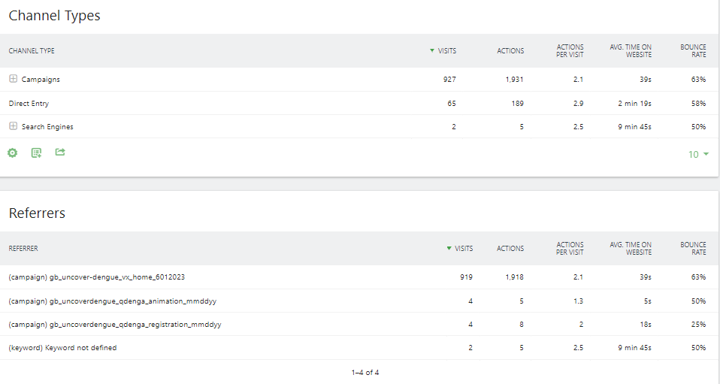
Acquisition
Mtm_content parameter not available in EDB. When you are testing multiple ads, and would include the name of each ad to see which was most effective for driving traffic
Measures to be created by channel/referrer types (campaigns, direct, search, social, website) for :
# Visits (Is this # Matomo Session Distinct Visitors)
#actions (Is this # Matomo Actions and Events)
actions per visit avg.
time on website
bounce rate (can’t see this in tables, is this available?)
% and # conversions, goal completions. % goal completions – of those that end up on site, how many completed goals by channel (ie % from a specific campaign that completed Takeda ID registrations with consent)
Screenshot from Matomo
How is # Matomo Session Distinct Visitors worked out? – If new session (user clears cookies), would they be counted
as new distinct visitor? Does it also include the # linked HCPs or is this only # unknown visitors (#linked HCPs +
# unknown Visitors OR #unknown visitors only?

Slide 14
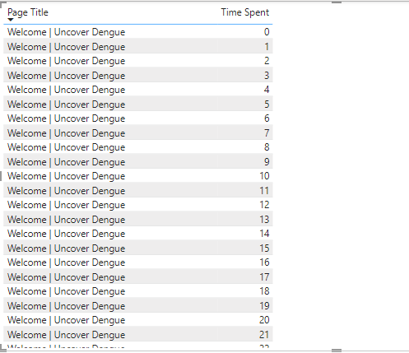
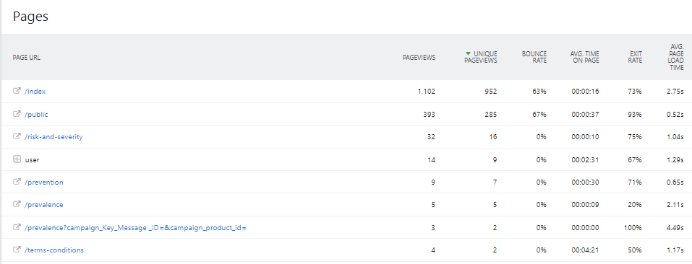
Behaviour
Can we look at the following measures for each page:
# Visits (Is this # Matomo Session Distinct Visitors)
# page views
Average time of page (“Time spent” doesn’t currently look like its linked)
bounce rate (can’t see this in tables, is this available?) - % that landed on this page and left
#Events
Exit rate (% of visits that left after this page)
% and # conversions, goal completions. % goal completions – of those that end up on site, how many completed goals by channel (ie % from a specific campaign that completed Takeda ID registrations with consent)
Screenshot from Matomo

Slide 15
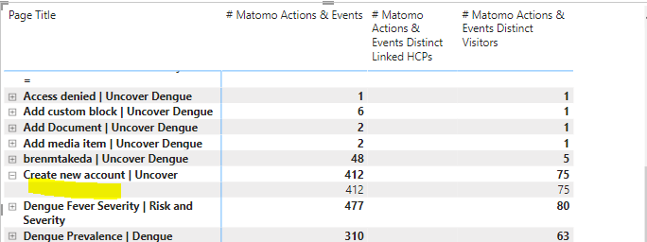
Behaviour – Events and Downloads
Event name
Ie scroll 25%,
Click, download
Can we show # events (linked, non-linked HCPs) by events (“event name”, category, action, type) that happened on
each page
Is the definition of action and event the same?
What does “Media” table refer to, is this videos on the website? Is this linked to Brightcove?
Conversion page – by source, medium, campaign

